Slide 1


DATA QUALITY INITIATIVE
2
+
2
+
A Step Towards Digitalization
Project Tenure: 2nd January 2020 – 1st July 2020
Industry Supervisor: Faculty Supervisor:
Mr. Saket Gupta Mr. Sumit Miglani
Commercial Manager Assistant Professor, CSED
Lufthansa Cargo T.I.E.T.
New Delhi Patiala

Slide 2
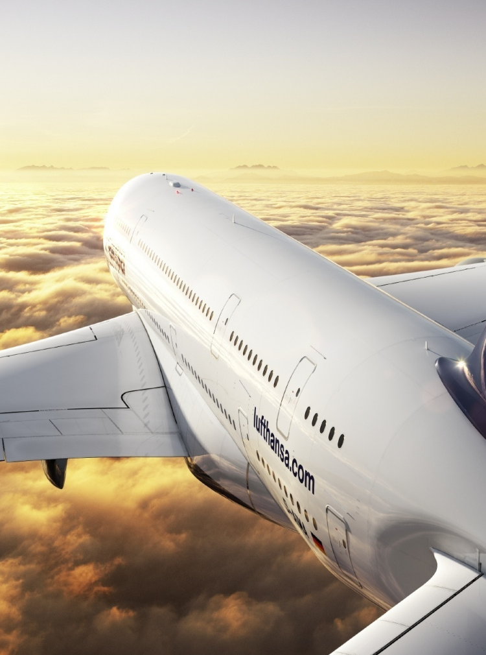
Table of Contents
Introduction to the company
Background of the project
Air WayBill vs e-AWB
Scope and Utility of the Project
Tools and Techniques Used
Process for e-AWB Acceptance
Block Diagram
Relevant Snapshot of the project
Professional Learning
Key Highlights of the Project
Feedback

Slide 3
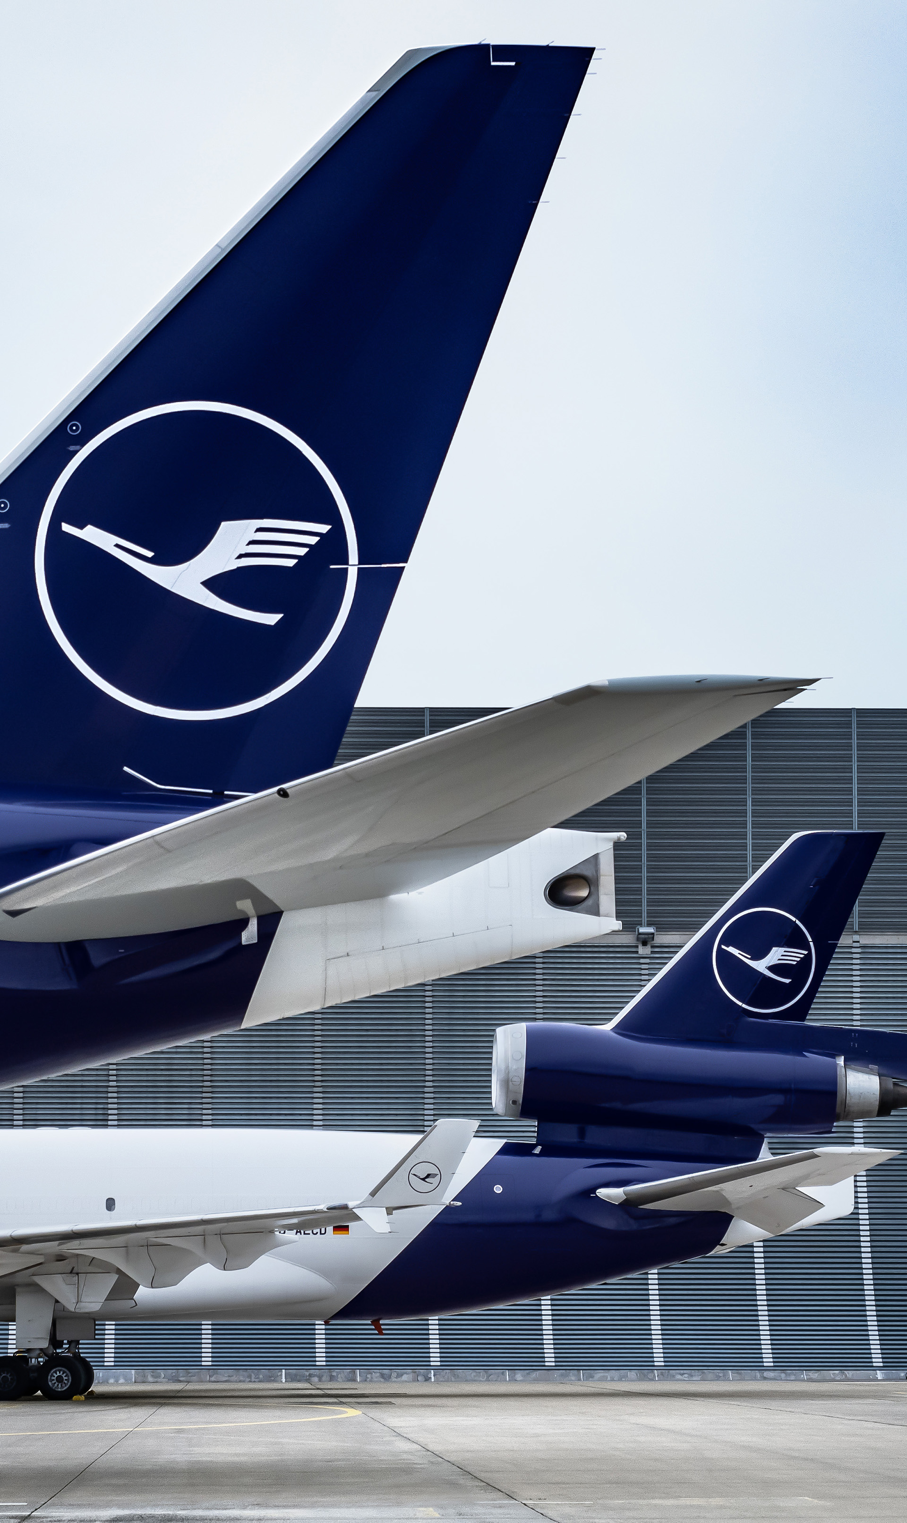

Introduction to the company
Among the largest cargo airlines across the globe.
Germany’s Flag Carrier.
361 destinations in 3 European hubs.
Wholly owned subsidiary of Lufthansa AG.
Fleet consists of various aircrafts including McDonnel Douglas MD 11-F, 6 Boeing 777F, Airbus 359,etc.
13 Freighters and air bellies of PAX flights sustain the functioning of Lufthansa Cargo.

Slide 4
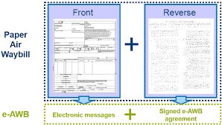
Background of the Project
Air Waybill – Documents containing information related to the cargo transported.
Documents sent along with cargo consist of 30 pages aimed to be converted to the digital form through e-AWB.
Done to replace Bilateral Agreements with Multilateral e-AWB Agreement by IATA.
Provisioned by IATA for conversion of paper AWBs to e-AWB.
Study of FWB Error Reference and FWB Validation Rules.

Slide 5
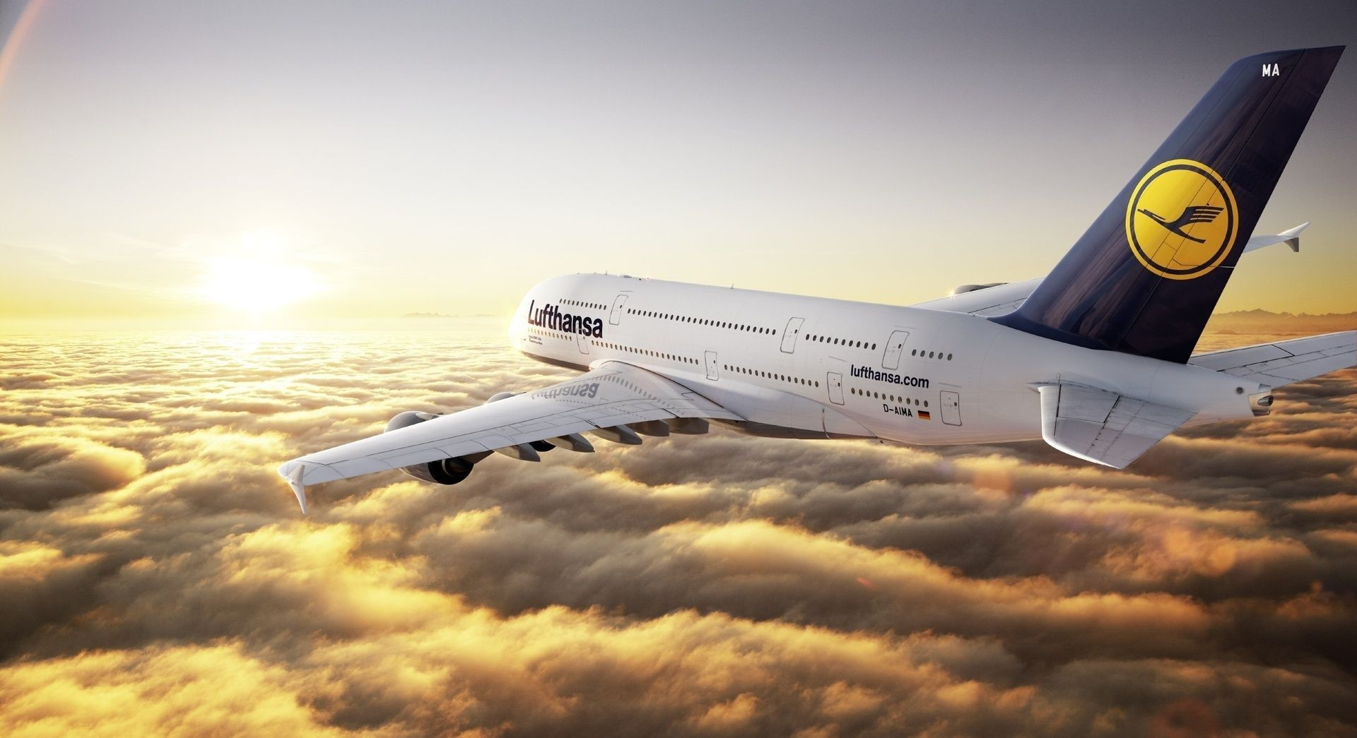
Air Waybill vs e-AWB

Slide 6
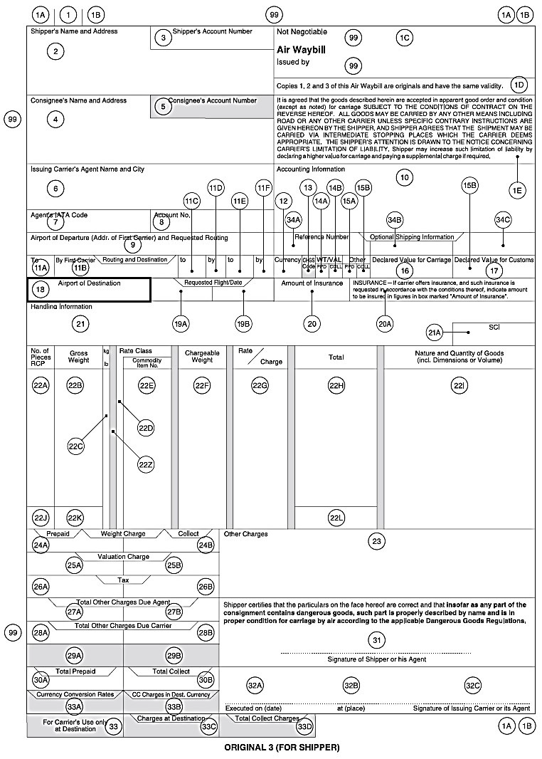
Air Waybill
Is a “contract of carriage” between “shipper” and “carrier”.
Contains details about Shipper, Consignee, Airline, Gross and Chargeable Weight, amount, etc.
1st copy(green) belongs to issuer.
2nd copy(pink) goes to receiver.
3rd copy(blue) goes to shipper.

Slide 7
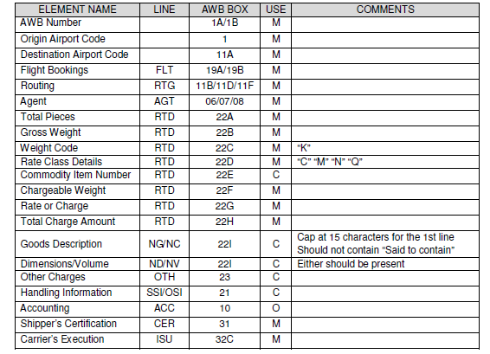
Format
of data
required for
e-AWB

Slide 8
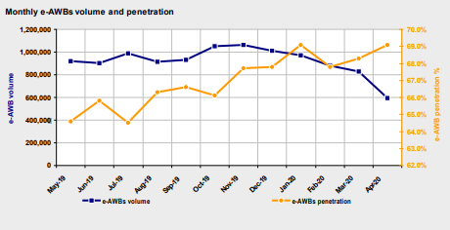
Scope and utility of the project
Scope pertains to all manually transmitted data that can be transmitted electronically.
Physical MAWB to be replaced by FWB.
Helps achieve IATA prescribed rate of e-AWB penetration by reducing dependence on paper AWB.
Helps prescribe the special handling code –ECC or ECP* to the forwarder.
Allows aircraft capacity to be used efficiently as space occupied by paper is reduced.

Slide 9



Tools and Techniques used
Microsoft Excel.
Microsoft PowerPoint.
Microsoft Word.
IBM Cognos Analytics.
In-house applications to view Manual and e-AWBs.
In-house reporting tools to access customer data.
In-house reporting tools to analyze consumer data.
In-house reporting tools to access shipments status.

Slide 10
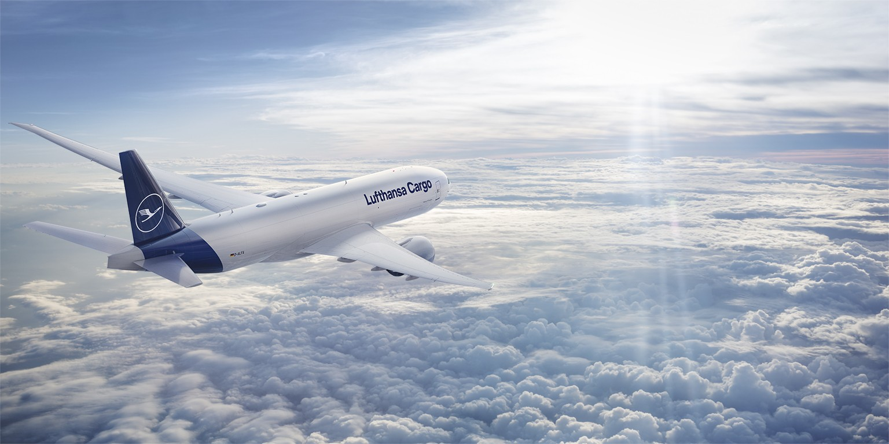
Process for e-AWB Acceptance

Slide 11
Process for e-AWB Acceptance
Freight Forwarder transmits FWB data to airline.
Airlines sends issues or acknowledgement to the freight forwarder.
Freight forwarder sends shipment along with pouch containing documents to final destination.

Slide 12
Process for e-AWB Acceptance
Airline compares FWB as per XFHL and sends data about discrepancies.
Airlines determines if shipment qualifies as e-AWB.
Airlines determines if Agent is ECC or ECP*.
If FWB matches actual shipment, Airline system updated for RCS.

Slide 13
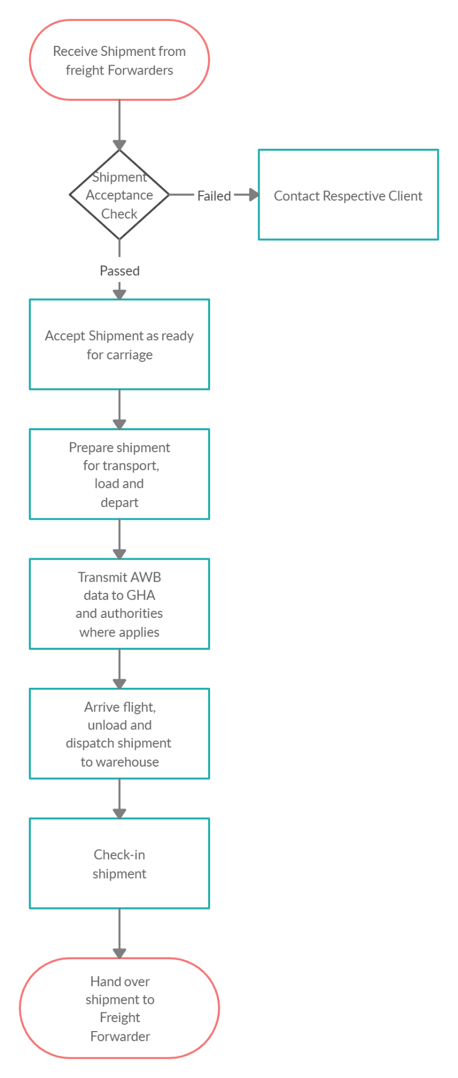
Block Diagram
The given block diagram defines the workflow of a paperless air-cargo process.
The process for shipment acceptance check is the main constituent of the project.
A full paperless air cargo process

Slide 14

Relevant snapshots of the project

Slide 15
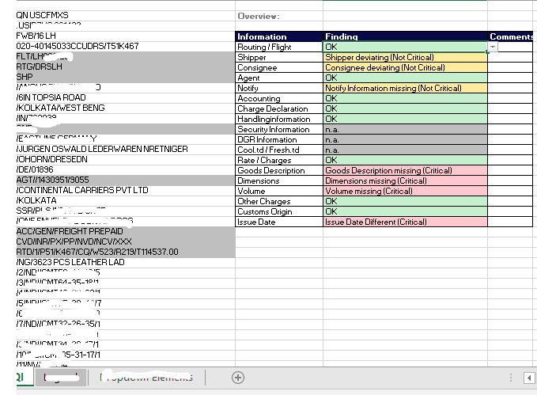
1. DQI Sheet – To calculate deviation

Slide 16
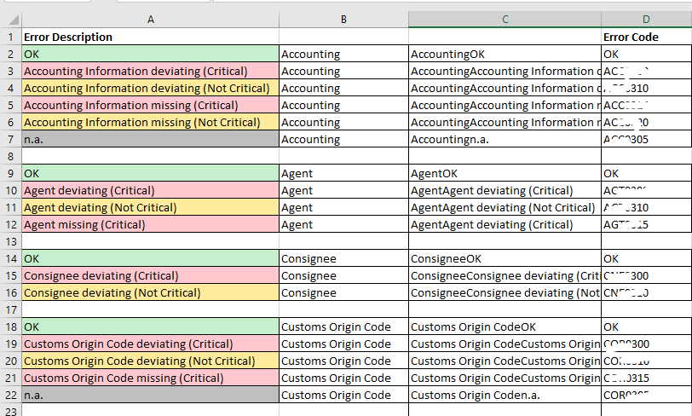
2. Error Code Sheet – To calculate magnitude of the deviation

Slide 17



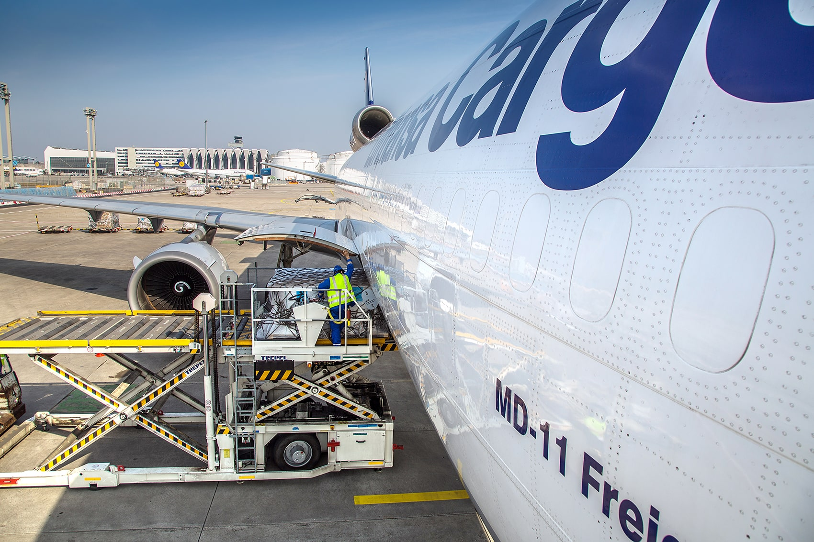
Professional Learnings
Marketing and marketing analysis using IBM Cognos.
Monitoring and analyzing data related to customers.
Reporting sales and operations of a cargo airline.
Develop and display trend analysis using Microsoft Excel and PowerPoint.
Gather data from various sources to develop customer performance reporting and competitor analysis.
Developing event planning strategies for various inside staff training and customer meets.

Slide 18

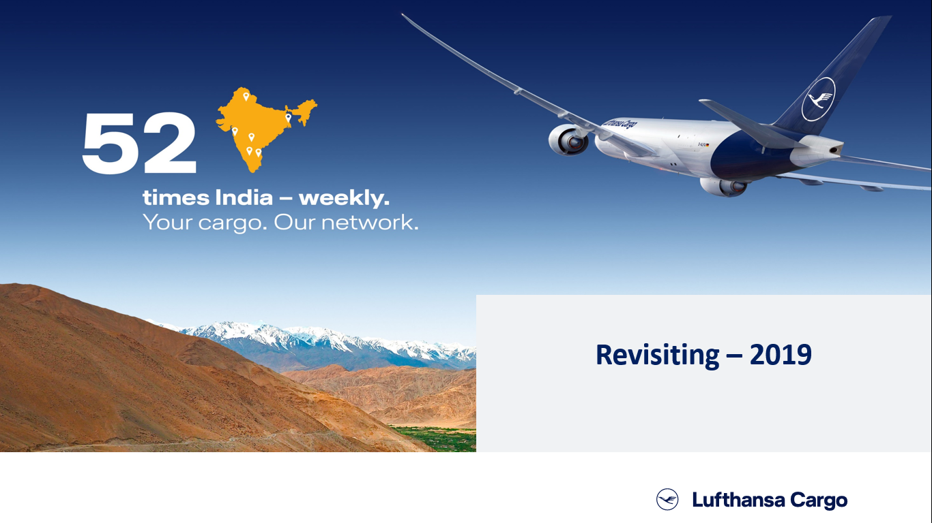

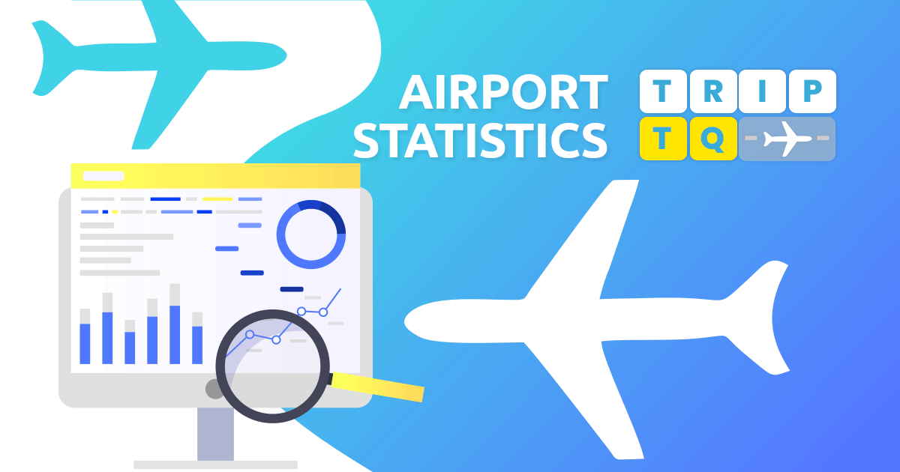
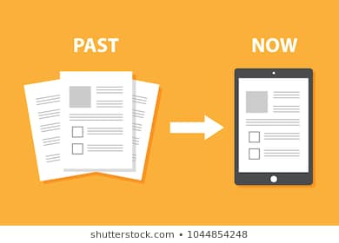
2
+
Key Highlights

Slide 19
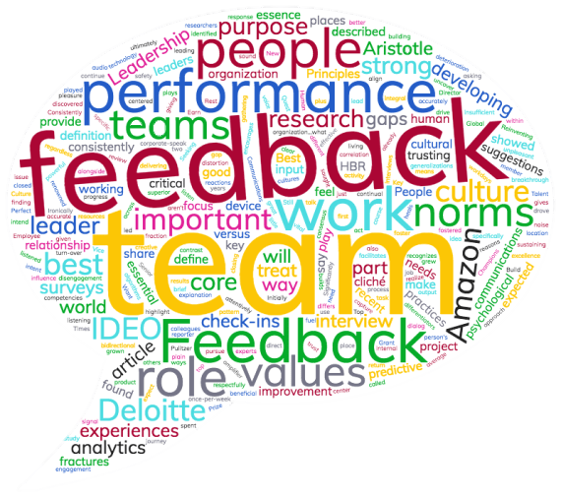
Feedback about Project Semester
Provided opportunity for personal and professional development.
Opportunity to work in a renowned multinational organization.
Helped enhance professional, technical and communication skills.
Opportunity to work under and seek guidance of highly experienced and trained professionals.
Well organized and well managed, as was evident by reaction to Covid-19 Crisis.

Slide 20
THANK YOU
2
+
2
+
Presented by:
Mansi(401603019)
BE-MBA 4th Year

